Slide 1

IOx GPS Data Publishing App for IR1800 IoT Routing Platform
GVE DevNet
Global Sales Segment : Global Service Provider/ Global Enterprise/Global Public Sector/Global Commercial and Small
Industries : Cities and Communities/Education/Financial Services/Government/Health Care/Manufacturing/Oil and Gas/Retail/Transportation/Utilities
LoB : Operations Automation/Operation Analytics
Architectural Plays : Enterprise
Sales Plays : Modernize the Workforce Experience for Enterprise/Transform Customer Experience/Manage the Application Experience/Other
Stien Vanderhallen
Technical Solutions Specialist
April 2022
Notes:
Notes: If your use case applies to morer than one or even all industries please keep all the industries and BOLD the industry where the PoV fits.
Smart City/Health Care/Industry and Manufacturing/Hospitality/Education/Retail/Utilities/Logistics/Professional Services/Public Sector/Service Provider
For LoB applies the same : if there is just one LoB, delete others, and bold the LoB that PoV is about.
LoB ; Safe and Security/Operations Automation/Human Resources/Operation Analytics
Please only keep the Architectural Plays that PoV is about.
Architectural Play : Enterprise / Data Center / Security / Collaboration / Service Provider

Slide 2

Enterprise
Operations Analytics
Notes:
Please under Industry Alignment just types the Industry that PoV was created as well LoB
For the pictures, when you go to the bx.cisco.com link and select brand categories and the select photograpy you can use the engine text box to look for industry pictures and download it

Slide 3
IOx GPS Data Publishing App
Business Needs/Challenges
Need: Customer has an internal application for monitoring router location.
Challenge: Cisco IoT routers do not natively allow to broadcast GPS data to a custom REST endpoint.
Solution
The solution is an IOx application that runs on Cisco IR1800 routing platforms. The app reads serial GPS data from the router, and publishes it both to local storage and a customizable REST endpoint. The publication interval can be adjusted by the user. When GPS data is unchanged, it is not published.
Business Outcomes
The customer can benefit from the Cisco IoT routing platform advantages, without having to compromise on using their internal applications. Moreover, the application is open to be customized further to accommodate future needs.
Notes:
Notes :
At the top Select a short name of the PoV naming product or products involved
Insert the logo f the customer when applies (if it is a general use case ignore the insert logo)
For Business Needs/Challenges :
For bullet Need : Write a small sentence that in an objective way to express the problem to solve when you refer to this problem, avoid to use technical words, uses business language as C-Level
For bullet Challenge : Write the main challenge and drawback the customer has to solve the problem (also avoid technical words, make a message in C-Level)
Solution :
Describe in a small sentence what is the solution about to deal with the problem referred, again, please avoid to uses technical words and use C-Level language
Business Outcomes:
Use small paragraph to show the benefits and gains with the solution explained above, please avoide to uses technical words and use C-Level language

Slide 4
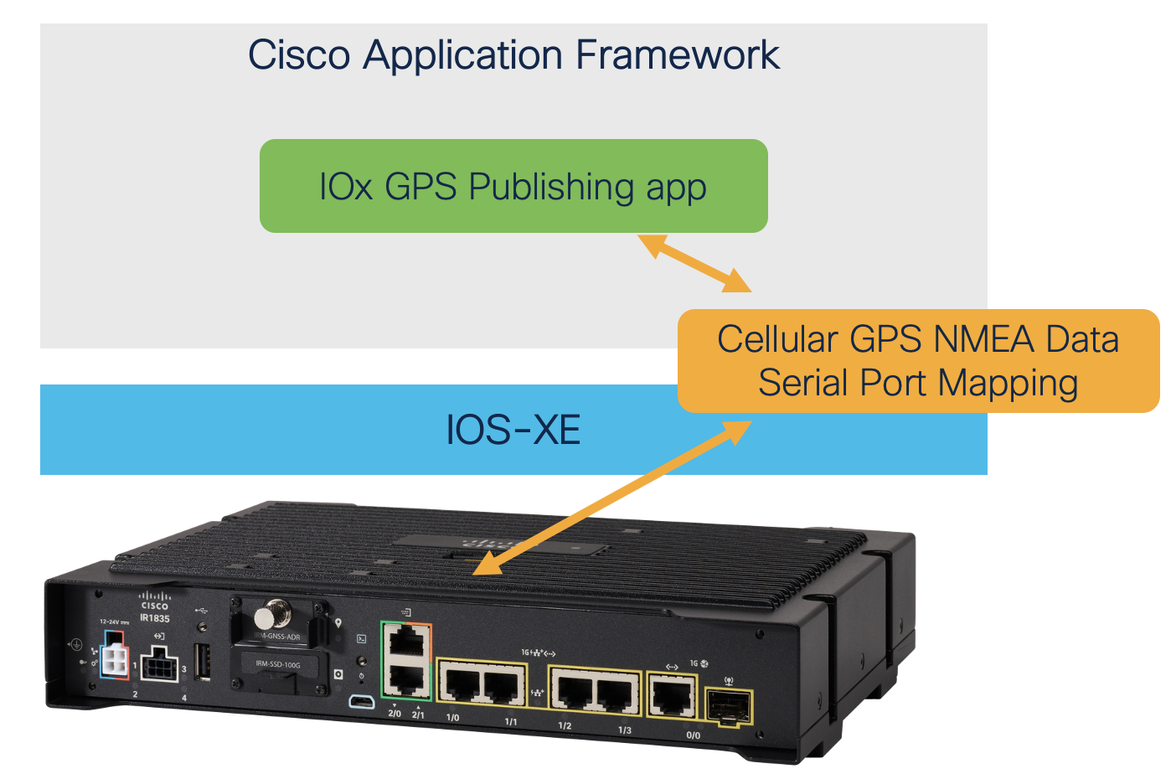

IOx GPS Data Publishing App
Notes:
Notes :
Use this slide to explain the story around your solution. It is a prototype in high level point of view. Think about a explanation of your solution to an executive that does not know Cisco and deep dive technology
This slide it is also to share knowledge with a non-technical guy (like BDM or sales or C-Level) what is the solution about and how will work . You can do as many steps as you need to describe the main flow of the solution
LINK for Icons https://www.flaticon.com/

Slide 5
IOx GPS Data Publishing App
Customer / Opportunity
Asset Digitisation is currently using Mikrotik devices running a Lisp script for publishing GPS data to their internal application.
What is the story? What was the business challenge?
The customer are interested in adopting Cisco IoT routing, yet unaware of how to migrate their Lisp script.
What the PoV accomplished?
The PoV is an IOx application publishing GPS data to a user-defined REST endpoint, as well as locally stored application logs.
What are the benefits to the customer?
The customer gains awareness of local application hosting on Cisco IoT routing platforms, as well as hindered less in the adoption of the platform.
Notes:
Notes :
*** From the side to the rest you can use all technical wording and reference from Cisco APIs, integrations and tools
Please fill the slide thinking about technical people and the scope of this PoV (what it is cover from the solution proposed and if there is a limitation or need a special integration to be awared
Align the bullet
What are the benefits to the customer?
With the Business Outcomes that you explain in the business case slide. And also you can add technical benefits on this slide or future steps to be added later as following steps

Slide 6
IOx GPS Data Publishing App
Customer Location Services Application
REST
https://wwwin-github.cisco.com/gve/gve_devnet_iox_gps_publishing
Notes:
Notes:
Describe the High level design and flow for the PoV and mentioned the tools used
Do not forget to add the link to github repository or other specifcs needs

Slide 7
IOx GPS Data Publishing App
Add GUI images or mobile app or mock ups
** If the PoV can’t not be replicated please record a video share the link
*** Video required for all submissions
Add link to the video url. [Portal Link]
Notes:
Notes :
Some of the PoVs are developed either Sandboxes from dcloud, devnet or customer premises lab.
In the case the PoV is execute under Customer Premises Lab and would be hard to replicate the PoV, Please record video with the Demo and add the link to it.

Slide 8
Tools (products) Used
IOx, IR1800, IoT, Python
Add link to the presentation url. [Portal Link]
Notes:
Notes :
Describe all the tools,
If there is a need for a specific licenses or code versión or hardware specifications mentioned here

Slide 9
Check out the GVE Devnet team @
https://gve-devnet.cisco.com/
Open a GVE case @
https://cep.cloudapps.cisco.com/case

